Slide 1
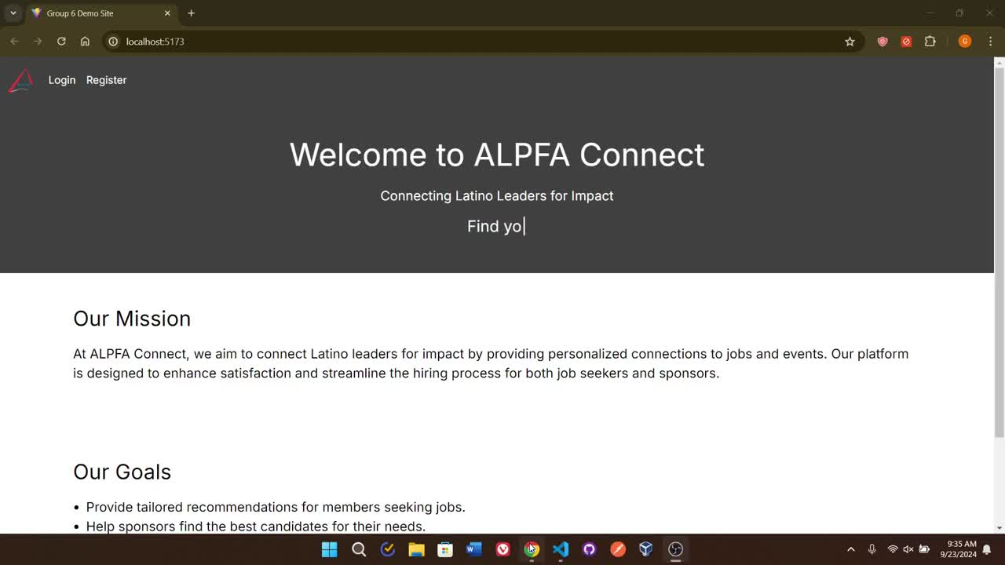
DEMO TIME

Slide 2




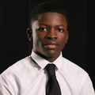

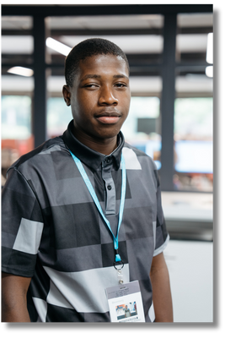
MEET THE TEAM
INGRID LUCAS
RODRIGO VENA
GAGE NOTARGIACOMO
DELIGHT NYANHETE
KAUSHIK CHITIPOTHU
MANASA SAI KARANAM
DANIEL ENESI
JUSTIS NAZIRBAGE
DANIEL OSUOHA

Slide 3
DEMO TIME

Slide 4

MISSION
Leadership Development
Career Development
Talent Acquisition

Slide 5





KEY FEATURES
JOB SEARCH
RECRUITER HIRING
SMART MATCH

Slide 6



THE ALPFA CONNECTION FLOW
ALPHA CONNECT
JOB SEEKER
JOB SPONSOR
REGISTER
REGISTER
UPDATE PROFILE
UPLOAD RESUME
FIND MATCHING JOBS
CONNECT VIA EMAIL
ADD JOB PREFERENCES
VIEW EVENTS
POST JOBS + EVENTS
AUTO PARSE JOB DESC
FIND MATCHING CANDIDATES
CONNECT VIA EMAIL
VIEW EVENTS
FEATURES OFFERED

Slide 7






ARCHITECTURE

Slide 8


ALPFA CONNECT FEATURES
EMAIL NOTIFICATIONS
STUDENT PROFILE
JOB ADMIN PROFILE
JOBS DASHBOAD
JOB RECOMMENDATION ENGINE
STUDENT RECOMMENDATION ENGINE
RESUME AUTO PARSER
JOB DESCRIPTION AUTO PARSER
EVENTS DASHBOAD

Slide 9
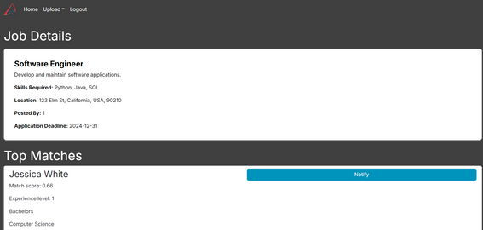
EMAIL SYSTEM

Slide 10
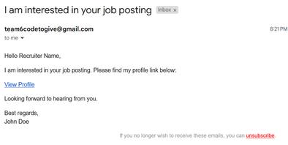
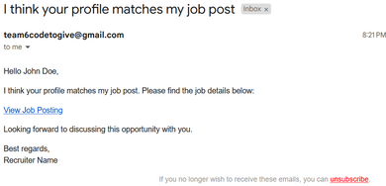
EMAIL SYSTEM

Slide 11
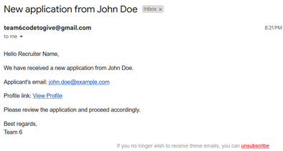
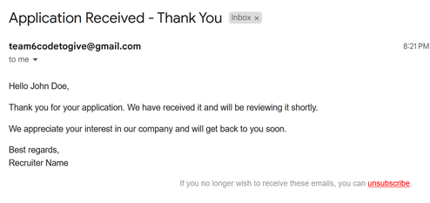
EMAIL SYSTEM

Slide 12
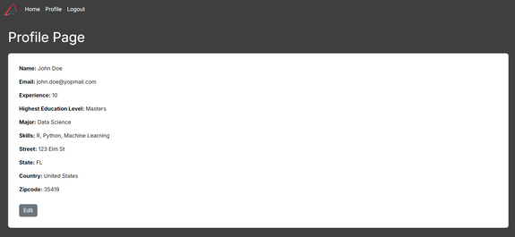
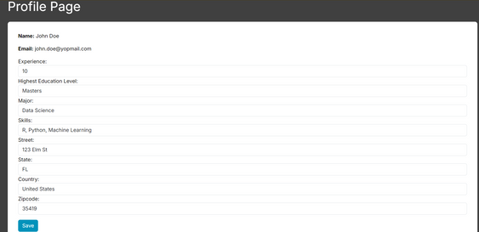
STUDENT PROFILE

Slide 13
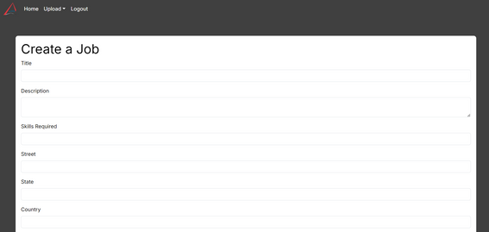
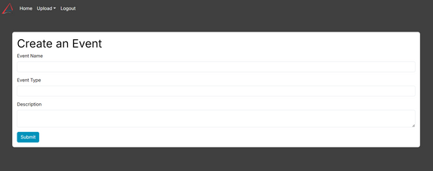
JOB ADMIN UPLOAD

Slide 14
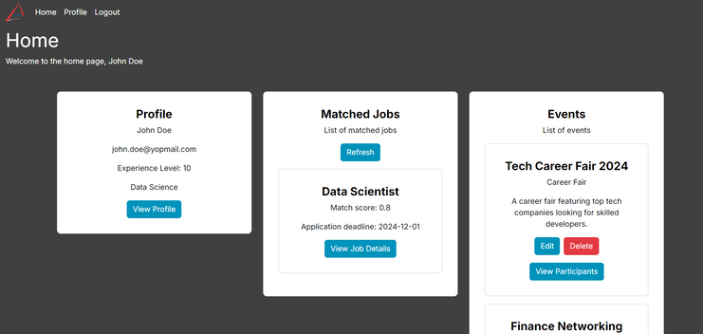
STUDENT DASHBOAD

Slide 15
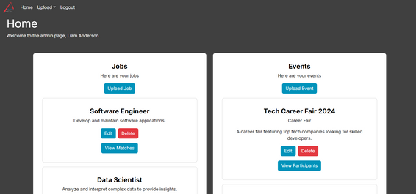
ADMIN DASHBOAD

Slide 16
JOB RECOMMENDATION ENGINE

Slide 17
STUDENT RECOMMENDATION ENGINE

Slide 18
EVENTS DASHBOAD

Slide 19
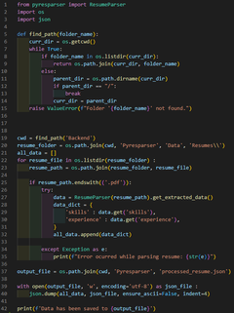
RESUME AUTO PARSER

Slide 20
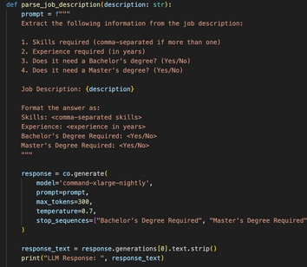
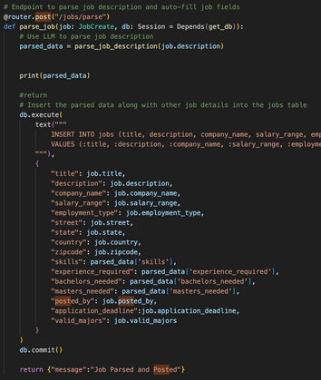
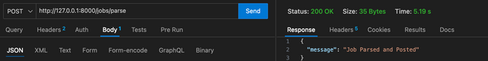
JOB DESCRIPTION AUTO PARSER

Slide 21
FUTURE ROADMAP
AI-Driven Profile Recommendations
Video Call Interview Integration
Real-Time Chat Support
Advanced Skill Matching Algorithms
Job Alerts & Notifications
Enhanced User Analytics Dashboard
Job & Event Search Filtering
Nearby Jobs/Students Map
Cross-Platform Mobile App Development

Slide 22

thank
you

